Slide 2
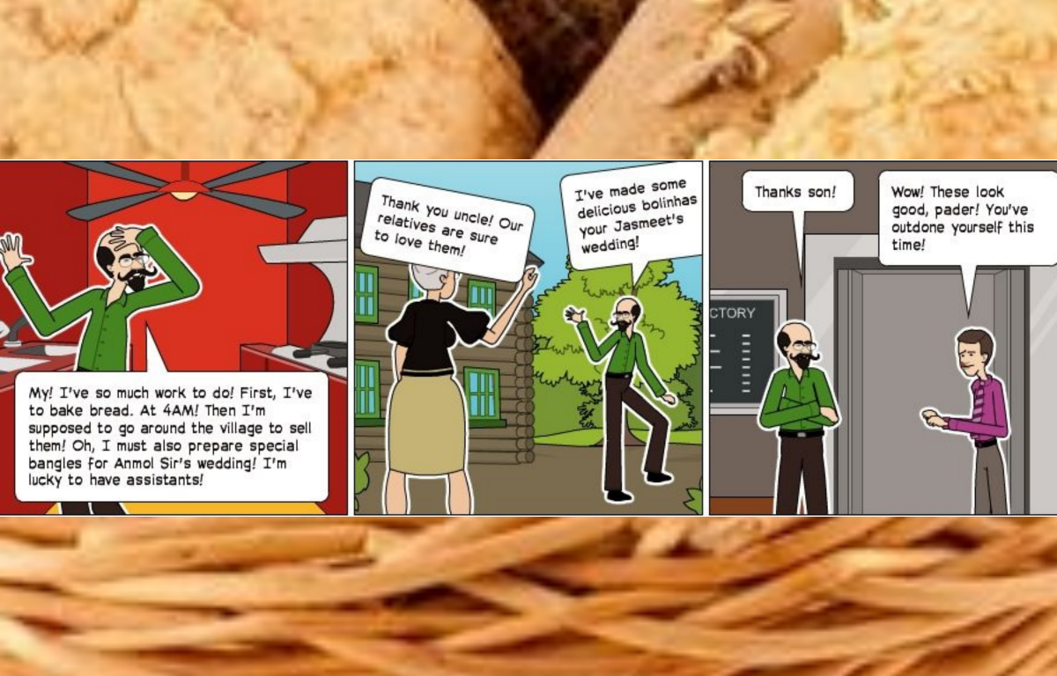
Just Read and Enjoy…

Slide 5
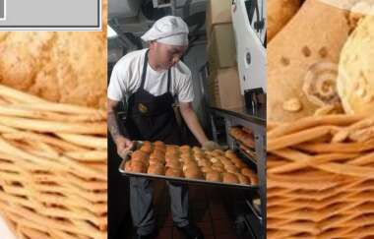
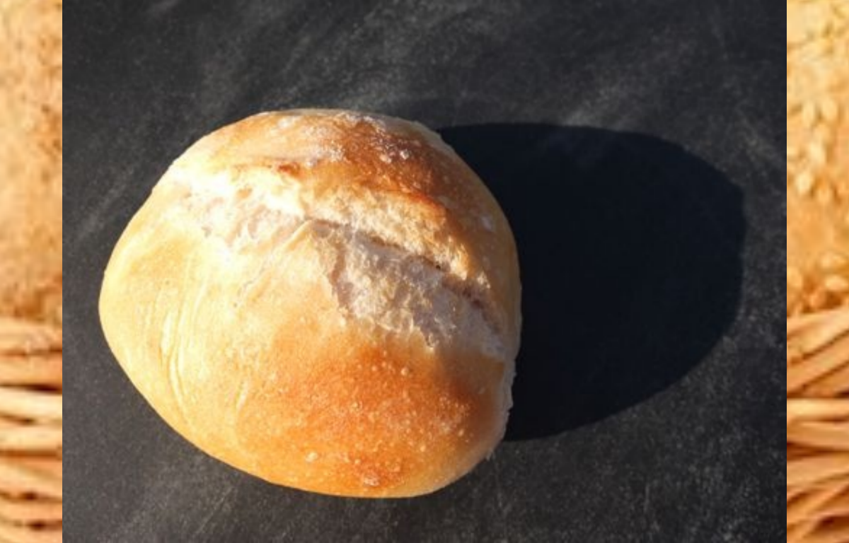
Summary
* Goa is very much influenced by Portuguese.
*Their traditional family work is baking bread. They are known as Pader in Goa .
*The writer tells about his childhood days and his friendship with bakers.
*In the morning the jingling sound of the bamboo woke them from sleep.
*Through one hand the baker supported the basket on his head and the other hand banged the
bamboo on the ground .
*The villagers were much fond of the sweet bread known as BOL.

Slide 6
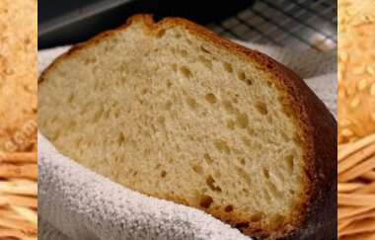
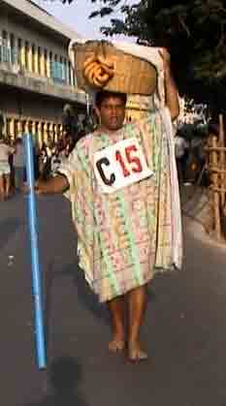
Summary
*It was one of the most essential marriage gifts.
*Bread sellers wore a particular dress known as Kabai. It was a single piece long frock up to the knees.
*They recorded their account on the wall in pencil. They always looked happy and prosperous.

Slide 7
Chapter in progress…Enjoy Reading.

Slide 8
Chapter in progress…Enjoy Reading.

Slide 9
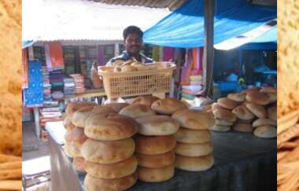
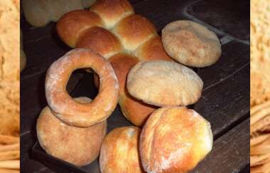
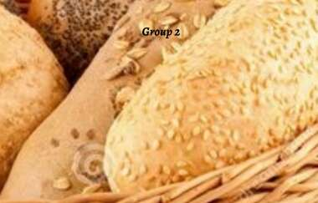
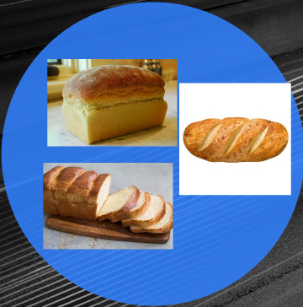
Chapter in progress…Enjoy Watching.

Slide 11
Important Word Meanings
Reminiscing nostalgically- Thinking fondly of the past
Moulders- a person who moulds dough into a shape Furnaces- an enclosed structure in which materials can be heated to very high temperatures Extinguished- cause a fire to cease to burn Heralding- announcing Pader- word for baker in Portuguese language
Parapet- railing, a low protective wall
Feast- a large meal, typically a celebratory one bolinhas - another name for coconut cookies
Plump physique- pleasantly fat body Open testimony- public statement about a character or quality

Slide 14
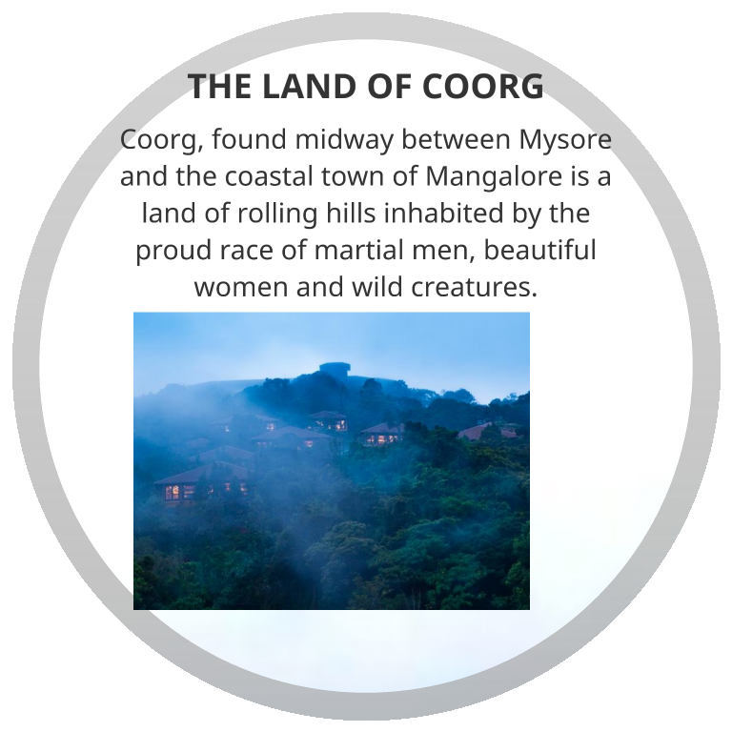

Slide 16
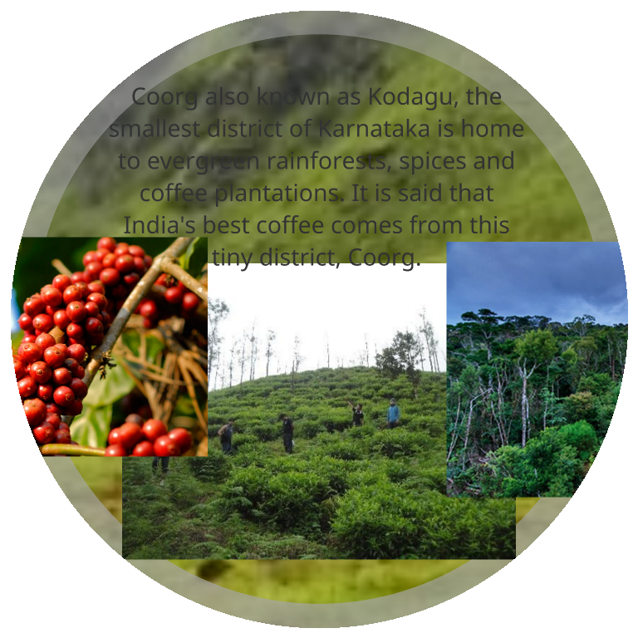
Geography

Slide 17
Geography

Slide 20
Culture and Tradition

Slide 21
Dress

Slide 22
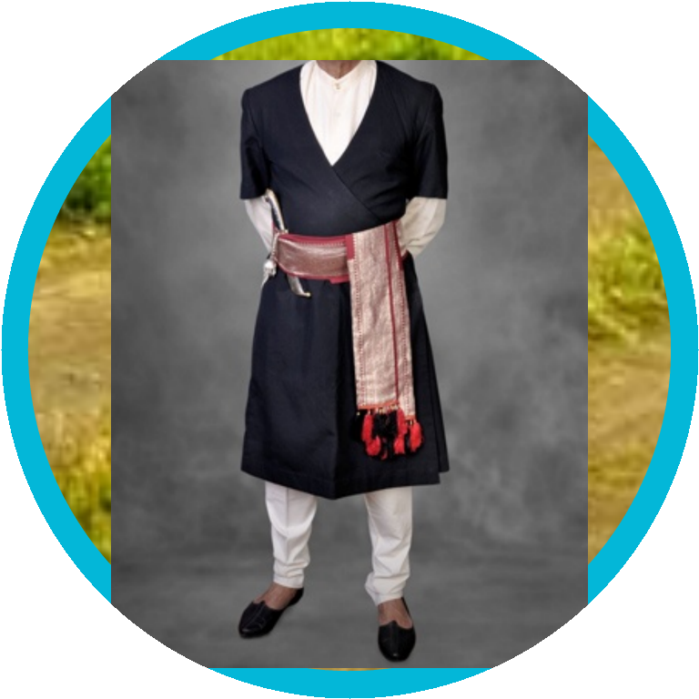
Dress

Slide 23
Homes

Slide 29
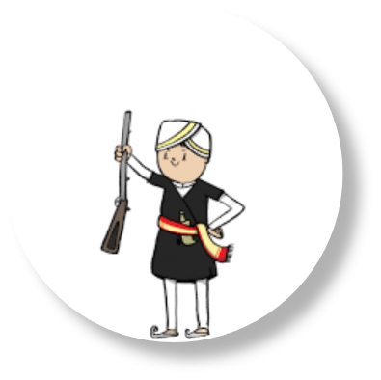
Important Word Meanings
Drifted from- been carried along gently by hair
Martial- having to do with war
Canopies- roof-like coverings made of trees that form a shelter Prime- here, best Invigorating- strong (here)
Mainstream- a tradition which most people follow
Tales of Valour- stories of courage and bravery, usually in a war Descent- origin
Most decorated- having received the maximum number of awards for bravery in a war
Ripple effect- a small wave or series of waves on the surface of water, especially as caused by a slight breeze or an object dropping into it Mahouts- a person who works with, rides, and tends an elephant
Laidback-relaxed, not in a hurry Rafting- travelling in a river in a raft (a floating platform made by tying planks together) Canoeing- travelling in a river in a canoe (a large, narrow boat) Rappelling- going down a cliff by sliding down a rope Trails- paths created by walking

Slide 31
Tea from Assam
Introduction – Pranjol's ,a youngster
from Assam is Rajvir ‘s classmate at
school in Delhi .Pranjol's ‘s father is the
manager of a tea garden in upper Assam
and Pranjol had invited Rajvir to visit his
home during the summer vacation .

Slide 32
Summary
Pranjol and Rajvir are class fellows in Delhi. Pranjol’s parents are living in Assam. His father is a manager of tea –garden in upper Assam. Rajvir is invited to Assam by Pranjol. In the train journey Rajvir told that over 8,00,000,000 cups of tea were drunk daily in the world. On the way they view a magnificent sight of tea bushes.
Pranjol told about the tea country and some legends about tea. Rajvir told that tea was first drunkin China. CHAI and CHINI have come from Chinese. In 16 century tea came to Europe as a
medicine .
th

Slide 33
Vocabulary
■
Use these words in sentences
of your own
■
whew,
■
Ardent
■
Sturdy
■
Billowing

Slide 34
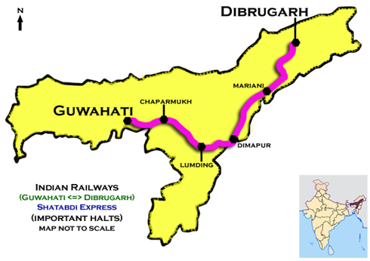
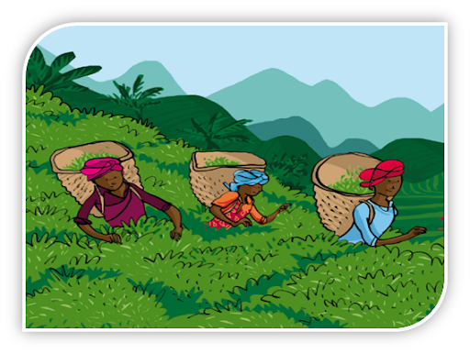
Important Word Meanings
Steaming- extremely hot
Exclaimed- cry out suddenly in surprise
Paddy fields- a field where rice is grown
Backdrop- lie behind or beyond; serve as a background to
As far as eye could see- for a long distance until something is so far away and small it cannot be seen anymore
Dwarfing- cause to seem small or insignificant in comparison
Sturdy- strong
Amidst- in the middle of
Billowing- moving or flowing outwards
Concentration- cluster
Ascetic- characterized by severe self-discipline and abstention from all forms of indulgence, typically for religious reasons.
Banished- get rid of
Gravel- small, rounded stones often mixed with sand
Pruned- cut away from a tree

